Slide 1
Salem Schools
Annual Report to the Public
September 16, 2019

Slide 2
Mission Statement
It is the mission of Salem Schools to educate all students by providing a challenging curriculum that promotes higher-order thinking skills, technology integration, and problem-solving through relevant and engaging activities. We will provide the experiences necessary for all students to become college and career ready.

Slide 3
Welcome to the 2019-2020 Annual Report to the Public
The Salem School District is fully accredited by the Arkansas Department of Education.
100% of teachers are licensed.
Current Enrollment - September 16, 2019
Elementary 442
High School 401 ________________
Total 843

Slide 4
Enrollment
2018-2019 Three quarter average = 849.21 2017-2018 Three quarter average = 838.16 2016-2017 Three quarter average = 800.48 2015-2016 Three quarter average = 785.23 2014-2015 Three quarter average = 771.50 2013-2014 Three quarter average = 790.83 2012-2013 Three quarter average = 756.10
Enrollment on ARP date 2019 = 843 Enrollment on ARP date 2018 = 854 Enrollment on ARP date 2017 = 834 Enrollment on ARP date 2016 = 800 Enrollment on ARP date 2015 = 780 Enrollment on ARP date 2014 = 764 Enrollment on ARP date 2013 = 796 Enrollment on ARP date 2012 = 748

Slide 5
Staff
110 Total Positions
102 Total Employees
- 8 teachers also drive a bus

Slide 6
New Staff Members
-Caitlin Gray - Mathematics -Brooke Faulkenberry - Language Arts, Oral Communications, Journalism, Yearbook -Alanna Russell - Business -Joseph Patten - School Resource Officer -Kent Andrews - Special Education Aide -Emanuel Brink - Computer Tech

Slide 7
Facilities
Efficiency allows us to continue to start and complete projects that improve our schools.
- 31.5 millage rate - Fifth lowest millage rate in the state - 38.5 state average - One report recognizes Salem as the 2nd most efficient school district in the state. - 1 of 2 schools that are debt free in the state.

Slide 8
Future Proofed Technology/Palo Alto Firewall

Slide 9
Replacing Wifi Access Points/LED Projects

Slide 10
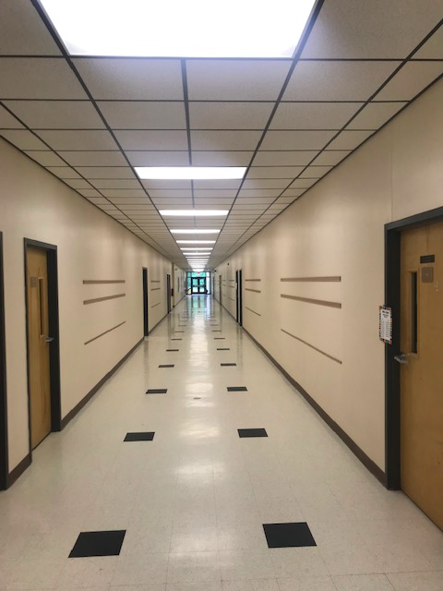
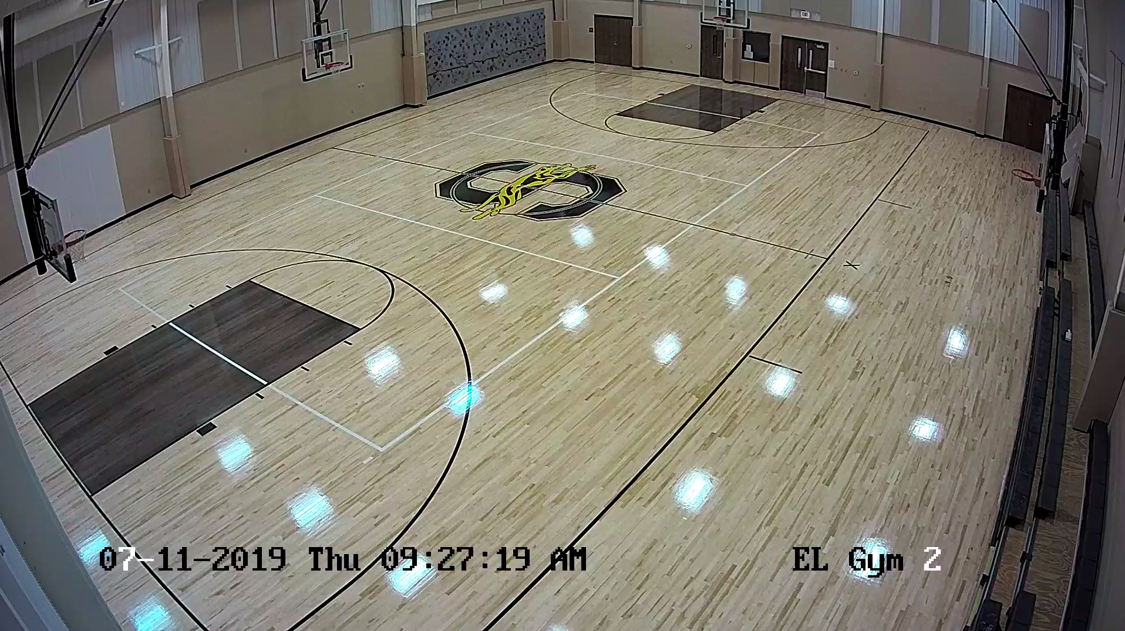
Refinish Gym Floors/Ceiling Grid Project

Slide 11
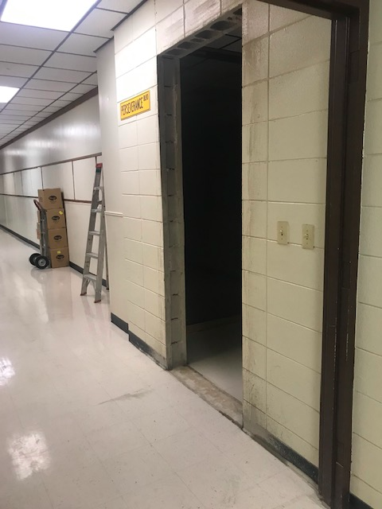
New Office for Mental Health Counseling Services

Slide 12
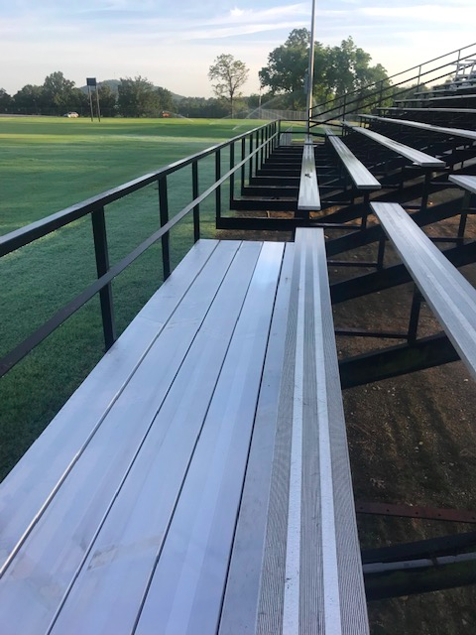
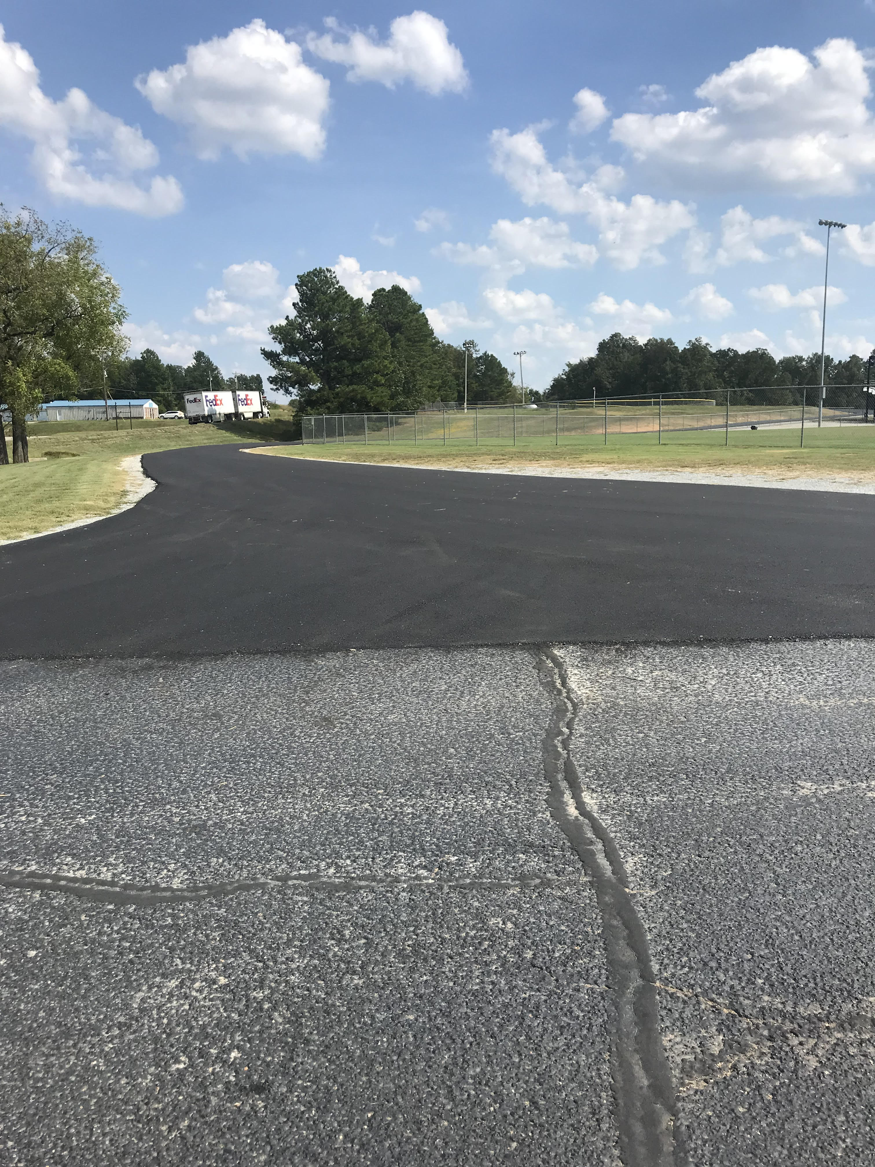
Completed Visitor Bleacher Project/Additional Asphalt Exit

Slide 13
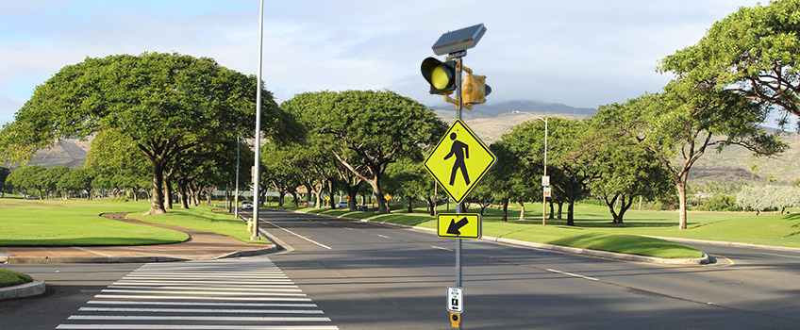
Speed Zone Solar Flashing Beacons

Slide 14
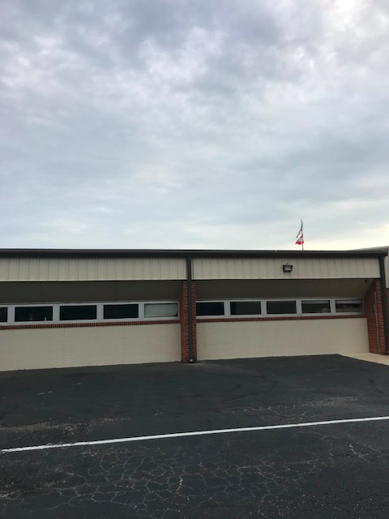
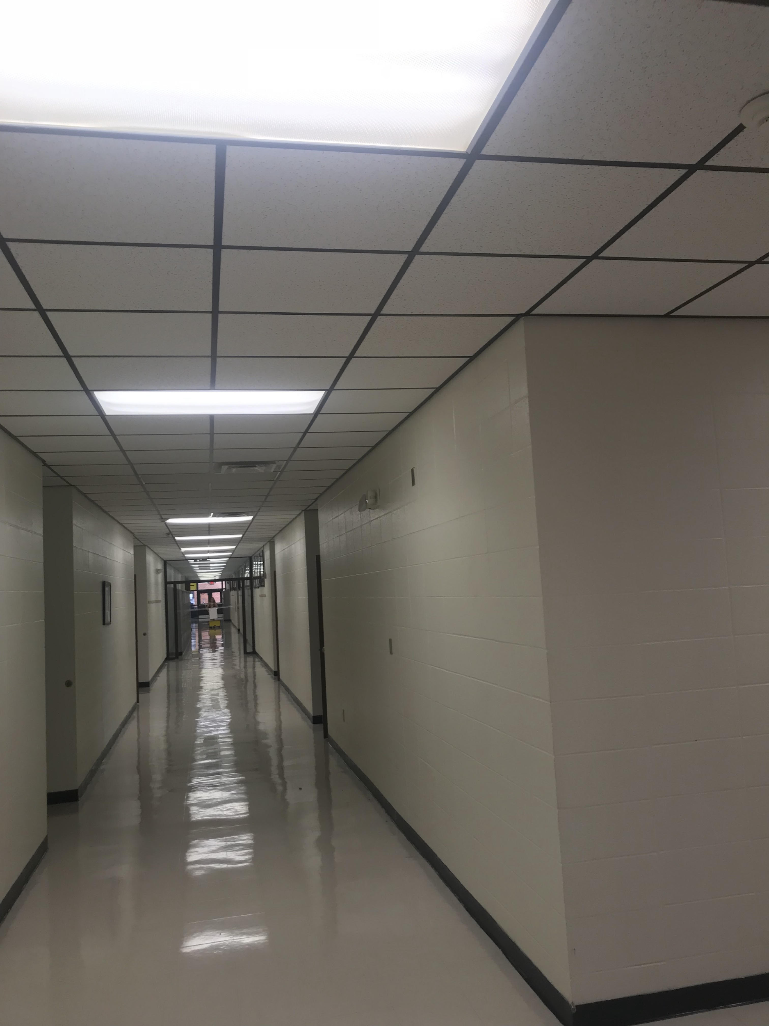
Numerous Painting Projects/Waxing Floors

Slide 15
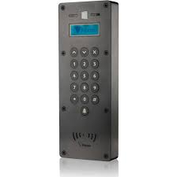
Door Access System at Salem High School

Slide 16
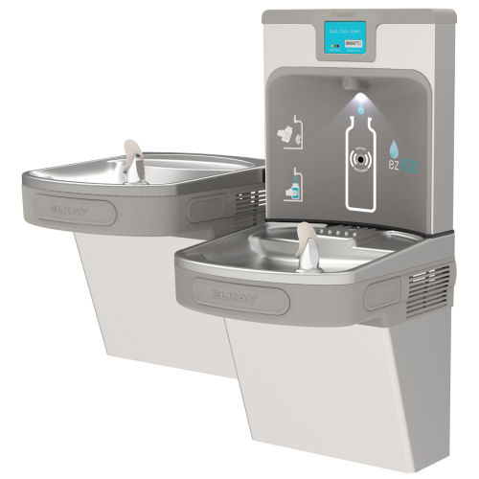
New Projects
Gathering information for Solar Energy and savings associated with solar panels.
Installing Vape detectors in bathrooms to give students another reason to say no.
Installing new water fountains with water bottle filling stations.
Six classroom addition to the high school.

Slide 17
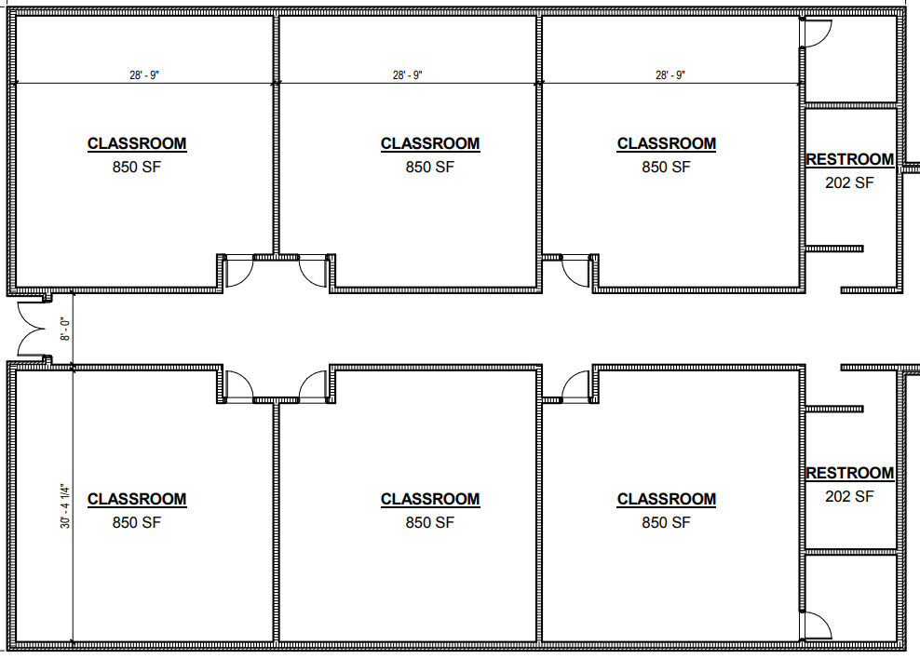
Six Classroom Addition

Slide 18
Academics/Other 2019-2020
Continued partnerships with colleges
Currently paying for one concurrent credit college course per semester for students interested in grades 9-12.
Other college courses cost:
$150 per 3 hour course through Ozarka
Courses through UAM are free to the student
ASUMH Technical courses are free to students
Added Concurrent Credit Welding course on campus/from 4-6 for adults also.
24 Hours paid by Salem Schools 15 Hours though ASUMH technical center 12 Hours through UAM 9 Ozarka hours paid by student
60 Hours - equivalent to Associates Degree $450 - On campus in state $20,000+

Slide 19
Academics/Other 2019-2020
Elementary Average | High School Average | District Average
63.67 | 55.97 | 59.82
62.71 | 48.66 | 55.68
54.41 | 51.93 | 53.17
56.59 | 47.15 | 51.87
54.05 | 46.82 | 50.44
52.36 | 46.78 | 49.57
47.25 | 51.78 | 49.52
53.39 | 43.65 | 48.52
49.42 | 46.71 | 48.06
46.75 | 45.30 | 46.02
42.43 | 49.47 | 45.95
44.33 | 45.57 | 44.95
43.62 | 42.68 | 43.15
43.28 | 41.77 | 42.53
41.35 | 30.97 | 36.16
30.09 | 25.80 | 27.95
Salem
Melbourne
Norfork
Viola
Mountain View
Mountain Home
Calico Rock
Mammoth Spring
Southside
Highland
Concord
Cave City
Batesville
ICC
Cedar Ridge
Midland

Slide 20
Parental Involvement
There is a parent center located in each office. The parent centers offer various types of literature for parents.
Current ways we are keeping parents informed: - Home Access Center (HAC) - Grades/Attendance - EZSchoolPay- Lunch Charges - Renaissance Place - Library - School Messenger - Phone Broadcast System - Newsletters - Website - www.salemschools.net - Social Media - Facebook, Twitter, parent resource center videos - Nutrislice

Slide 21
Salem School Parent Resource Series
Short video series for parents to help with programs that are used at Salem Schools.
Located on Facebook and Twitter
GoMath
EZSchoolPay
Nurtislice
Door Access Systems
More to come in 2019-2020

Slide 22
Vending Report
Revenue Salem Schools received $1,142.00 in vending revenue from Coca-Cola during the 2018-2019 school year. Commission $1,142.00
Total $1,142.00
Expenses Coffee $ 1,142.00
Total $1,142.00

Slide 23
Goals
Academic
Close the achievement gap between the general population and the TAGG population
Continue to provide quality training for staff members
Find new ways to ensure that parents are informed about their child’s progress
Continue ACT Aspire formative assessments throughout the school year
Continue to explore partnership options with colleges
Continue to offer a safe learning environment
For a copy of this PPT - www.salemschools.net

Slide 24
Contact Information
Wayne Guiltner Superintendent, Salem School District wayne.guiltner@salemschools.net 870-895-2516 (o) 870-371-0323 (c)

